Slide 1
ARM PROCESSOR FUNDAMENTALS

Slide 2
The ARM processor core is a key component of many successful 32-bit embedded systems
ARM cores are widely used in mobile phones, handheld organizers, and a multitude of other everyday portable consumer devices

Slide 3
The first ARM1 prototype was designed in 1985
Over one billion ARM processors had been shipped worldwide by the end of 2001
The ARM Company bases their success on a simple and powerful original design, which continues to improve today through constant technical innovation

Slide 4
THE RISC DESIGN PHYLOSOPHY:
The ARM core uses reduced instruction set computer (RISC) architecture
RISC is a design philosophy aimed at delivering simple but powerful instructions that execute within a single cycle at a high clock speed

Slide 5
The RISC philosophy concentrates on reducing the complexity of instructions performed by the hardware because it is easier to provide greater flexibility and intelligence in software rather than hardware
As a result, a RISC design places greater demands on the compiler

Slide 6
In contrast, the traditional complex instruction set computer (CISC) relies more on the hardware for instruction functionality, and consequently the CISC instructions are more complicated

Slide 7
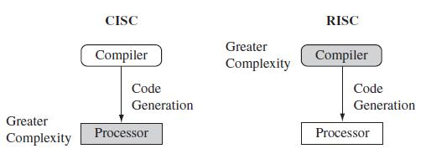

Slide 8
CISC | RISC
Complex instructions, taking multiple clock | Simple instructions, taking single clock
Emphasis on hardware, complexity is in the micro-program/processor | Emphasis on software, complexity is in the Complier
Complex instructions, instructions executed by micro-program/processor | Reduced instructions, instructions executed by Hardware
Variable format instructions, single register set and many instructions | Fixed format instructions, multiple register sets and few instructions
Many instructions and many addressing modes | Fixed instructions and few addressing modes
Conditional jump is usually based on status register bit | Conditional jump can be based on a bit anywhere in memory
Memory reference is embedded in many instructions | Memory reference is embedded in LOAD/STORE instructions

Slide 9
The RISC philosophy is implemented with four major design rules:
Instructions
Pipelines
Registers
Load-store architecture

Slide 10
Instructions
RISC processors have a reduced number of instruction classes
These classes provide simple operations that can each execute in a single cycle
The compiler or programmer synthesizes complicated operations (for example, a divide operation) by combining several simple instructions

Slide 11
Each instruction is having fixed length to allow the pipeline to fetch future instructions before decoding the current instruction
In contrast, in CISC processors the instructions are often of variable size and take many cycles to execute

Slide 12
Pipelines
The processing of instructions is broken down into smaller units that can be executed in parallel by pipelines
Ideally the pipeline advances by one step on each cycle for maximum throughput

Slide 13
Instructions can be decoded in one pipeline stage
There is no need for an instruction to be executed by a mini-program called microcode as on CISC processors

Slide 14
Registers
RISC machines have a large general-purpose register set
Any register can contain either data or an address

Slide 15
Registers act as the fast local memory store for all data processing operations
In contrast, CISC processors have dedicated registers for specific purposes

Slide 16
Load-store architecture
The processor operates on data held in registers
Separate load and store instructions transfer data between the register bank and external memory

Slide 17
Memory accesses are costly, so separating memory accesses from data processing provides an advantage because you can use data items held in the register bank multiple times without needing multiple memory accesses
In contrast, with a CISC design the data processing operations can act on memory directly

Slide 18
These design rules allow a RISC processor to be simpler, and thus the core can operate at higher clock frequencies
In contrast, traditional CISC processors are more complex and operate at lower clock frequencies

Slide 19
THE ARM DESIGN PHYLOSOPHY
There are a number of physical features that have driven the ARM processor design
Portable embedded systems require battery power
The ARM processor has been specially designed to be small to reduce power consumption and extend battery operation—essential for applications such as mobile phones and personal digital assistants (PDAs)

Slide 20
High code density is another major requirement since embedded systems have limited memory due to cost and/or physical size restrictions—useful for applications that have limited on-board memory, such as mobile phones and mass storage devices

Slide 21
Embedded systems are price sensitive
Hence, use slow and low-cost memory devices to get substantial savings—essential for high-volume applications like digital cameras
Also, reduce the area of the die taken up by the embedded processor; smaller the area used by the embedded processor, reduced cost of the design and manufacturing for the end product

Slide 22
ARM has incorporated hardware debug technology within the processor so that software engineers can view what is happening while the processor is executing code
With greater visibility, software engineers can resolve issues faster
The ARM core is not a pure RISC architecture because of the constraints of its primary application—the embedded system
In some sense, the strength of the ARM core is that it does not take the RISC concept too far

Slide 23
Instruction Set for Embedded Systems
The ARM instruction set differs from the pure RISC definition in several ways that make the ARM instruction set suitable for embedded applications

Slide 24
Variable cycle execution for certain instructions
Not every ARM instruction executes in a single cycle
For example, load-store-multiple instructions vary in the number of execution cycles depending upon the number of registers being transferred

Slide 25
The transfer can occur on sequential memory addresses
Code density is also improved since multiple register transfers are common operations at the start and end of functions

Slide 26
Inline barrel shifter leading to more complex instructions
The inline barrel shifter is a hardware component that preprocesses one of the input registers before it is used by an instruction
This expands the capability of many instructions to improve core performance and code density

Slide 27
In many processors, shifting requires a separate instruction. But in ARM processors, the barrel shifter is built directly into the data processing path of the ALU.
Register Rn ---------> ALU
Register Rm -> Barrel Shifter -> ALU |
Shift Operation

Slide 28
Example ARM instruction:
ADD R0, R1, R2, LSL #2
Meaning:
R0 = R1 + (R2 << 2)
Steps happening internally:
R2 goes to the barrel shifter
It performs LSL #2
The shifted value is sent to the ALU
ALU performs addition with R1
Result stored in R0
All done in one instruction cycle.

Slide 29
Thumb 16-bit instruction set
ARM enhanced the processor core by adding a second 16-bit instruction set called Thumb that permits the ARM core to execute either 16- or 32-bit instructions
The 16-bit instructions improve code density by about 30% over 32-bit fixed-length instructions
Thumb instruction set = 16-bit compressed instruction set of ARM used to improve code density in embedded systems.

Slide 30
Conditional execution
An instruction is only executed when a specific condition has been satisfied
This feature improves performance and code density by reducing branch instructions

Slide 31
Enhanced instructions
The enhanced digital signal processor (DSP) instructions were added to the standard ARM instruction set to support fast 16×16-bit multiplier operations
These instructions allow a faster-performing ARM processor

Slide 32
These additional features have made the ARM processor one of the most commonly used 32-bit embedded processor cores

Slide 33
EMBEDDED SYSTEM HARDWARE
The following Figure shows a typical embedded device based on an ARM core
Each box represents a feature or function
The lines connecting the boxes are the buses carrying data

Slide 34
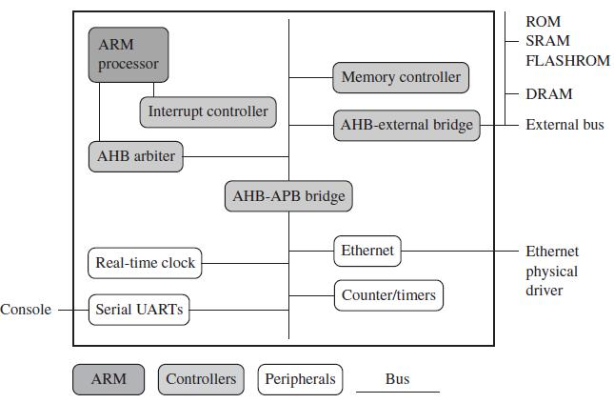

Slide 35
We can separate the device into four main hardware components:
The ARM processor
The Controllers
The peripherals
The Bus

Slide 36
The ARM processor controls the embedded device
Different versions of the ARM processor are available to suit the desired operating characteristics
An ARM processor comprises a core (the execution engine that processes instructions and manipulates data) plus the surrounding components (memory and cache) that interface it with a bus

Slide 37
Controllers coordinate important functional blocks of the system
Two commonly found controllers are interrupt and memory controllers

Slide 38
The peripherals provide all the input-output capability external to the chip and are responsible for the uniqueness of the embedded device
A bus is used to communicate between different parts of the device

Slide 39
ARM Bus Technology
Embedded devices use an on-chip bus that is internal to the chip and that allows different peripheral devices to be interconnected with an ARM core
There are two different classes of devices attached to the bus

Slide 40
The ARM processor core is a bus master - a logical device capable of initiating a data transfer with another device across the same bus
Peripherals tend to be bus slaves - logical devices capable only of responding to a transfer request from a bus master device

Slide 41
A bus has two architecture levels:
A physical level - covers the electrical characteristics and bus width (16, 32, or 64 bits)
The protocol - the logical rules that govern the communication between the processor and a peripheral

Slide 42
AMBA Bus Protocol
The Advanced Microcontroller Bus Architecture (AMBA) was introduced in 1996 and has been widely adopted as the on-chip bus architecture used for ARM processors
The first AMBA buses introduced were the ARM System Bus (ASB) and the ARM Peripheral Bus (APB)
Later ARM introduced another bus design, called the ARM High Performance Bus (AHB)

Slide 43
Using AMBA, peripheral designers can reuse the same design on multiple projects
A peripheral can simply be bolted onto the on-chip bus without having to redesign an interface for each different processor architecture
This plug-and-play interface for hardware developers improves availability and time to market

Slide 44
AHB provides higher data throughput than ASB because it is based on a centralized multiplexed bus scheme rather than the ASB bidirectional bus design
This change allows the AHB bus to run at higher clock speeds.

Slide 45
ARM has introduced two variations on the AHB bus: Multi-layer AHB and AHB-Lite
The Multi-layer AHB bus allows multiple active bus masters
AHB-Lite is a subset of the AHB bus and it is limited to a single bus master

Slide 46
The example device shown in the above Figure has three buses:
An AHB bus for the high performance peripherals
An APB bus for the slower peripherals
A third bus for external peripherals, proprietary to this device

Slide 47
Memory
An embedded system has to have some form of memory to store and execute code
You have to compare price, performance, and power consumption when deciding upon specific memory characteristics, such as hierarchy, width, and type

Slide 48
Hierarchy:
All computer systems have memory arranged in some form of hierarchy
The following Figure shows the memory trade-offs: the fastest memory cache is physically located nearer the ARM processor core and the slowest secondary memory is set further away
Generally the closer memory is to the processor core, the more it costs and the smaller its capacity

Slide 49
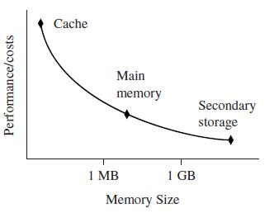
Memory Storage Trade-offs

Slide 50
The cache is placed between main memory and the core
It is used to speed up data transfer between the processor and main memory
A cache provides an overall increase in performance but with a loss of predictable execution time
Although the cache increases the general performance of the system, it does not help real-time system response

Slide 51
The main memory is large—around 256 KB to 256 MB (or even greater), depending on the application—and is generally stored in separate chips
Load and store instructions access the main memory unless the values have been stored in the cache for fast access

Slide 52
Secondary storage is the largest and slowest form of memory
Hard disk drives and CD-ROM drives are examples of secondary storage

Slide 53
Width
The memory width is the number of bits the memory returns on each access—typically 8, 16, 32, or 64 bits
The memory width has a direct effect on the overall performance and cost ratio
Lower bit memories are less expensive, but reduce the system performance
The following Table summarizes theoretical cycle times on an ARM processor using different memory width devices

Slide 54
Table: Fetching Instruction from Memory
Instruction Size | 8-bit Memory | 16-bit Memory | 32-bit Memory
ARM 32-bit | 4 cycles | 2 cycles | 1 cycles
Thumb 16-bit | 2 cycles | 1 cycles | 1 cycles

Slide 55
There are many different types of memory:
Read-only memory (ROM) is the least flexible of all memory types because it contains an image that is permanently set at production time and cannot be reprogrammed
ROMs are used in high-volume devices that require no updates or corrections
Many devices also use a ROM to hold boot code

Slide 56
Flash ROM can be written to as well as read, but it is slow to write so you shouldn’t use it for holding dynamic data
Its main use is for holding the device firmware or storing long-term data that needs to be preserved after power is off
The erasing and writing of flash ROM are completely software controlled with no additional hardware circuitry required, which reduces the manufacturing costs

Slide 57
Dynamic random access memory (DRAM) is the most commonly used RAM for devices
It has the lowest cost per megabyte compared with other types of RAM
DRAM is dynamic - it needs to have its storage cells refreshed and given a new electronic charge every few milliseconds, so you need to set up a DRAM controller before using the memory

Slide 58
Static random access memory (SRAM) is faster than the more traditional DRAM, but requires more silicon area
SRAM is static - the RAM does not require refreshing
The access time for SRAM is considerably shorter than the equivalent DRAM because SRAM does not require a pause between data accesses
But cost of SRAM is high

Slide 59
Synchronous dynamic random access memory (SDRAM) is one of many subcategories of DRAM
It can run at much higher clock speeds than conventional memory
SDRAM synchronizes itself with the processor bus, because it is clocked
Internally the data is fetched from memory cells, pipelined, and finally brought out on the bus in a burst

Slide 60
Peripherals
Embedded systems that interact with the outside world need some form of peripheral device
A peripheral device performs input and output functions for the chip by connecting to other devices or sensors that are off-chip

Slide 61
Each peripheral device usually performs a single function and may reside on-chip
Peripherals range from a simple serial communication device to a more complex 802.11 wireless device

Slide 62
All ARM peripherals are memory mapped - the programming interface is a set of memory-addressed registers
The address of these registers is an offset from a specific peripheral base address
Controllers are specialized peripherals that implement higher levels of functionality within an embedded system
Two important types of controllers are memory controllers and interrupt controllers

Slide 63
Memory Controllers
Memory controllers connect different types of memory to the processor bus
On power-up a memory controller is configured in hardware to allow certain memory devices to be active
These memory devices allow the initialization code to be executed
Some memory devices must be set up by software; for example, when using DRAM, you first have to set up the memory timings and refresh rate before it can be accessed

Slide 64
Interrupt Controllers
When a peripheral or device requires attention, it raises an interrupt to the processor
An interrupt controller provides a programmable governing policy that allows software to determine which peripheral or device can interrupt the processor at any specific time by setting the appropriate bits in the interrupt controller registers

Slide 65
There are two types of interrupt controller available for the ARM processor: the standard interrupt controller and the vector interrupt controller
The standard interrupt controller sends an interrupt signal to the processor core when an external device requests servicing

Slide 66
It can be programmed to ignore or mask an individual device or set of devices
The interrupt handler determines which device requires servicing by reading a device bitmap register in the interrupt controller

Slide 67
The vector interrupt controller (VIC) is more powerful than the standard interrupt controller, because it prioritizes interrupts and simplifies the determination of which device caused the interrupt
Depending on the type, the VIC will either call the standard interrupt exception handler, which can load the address of the handler

Slide 68
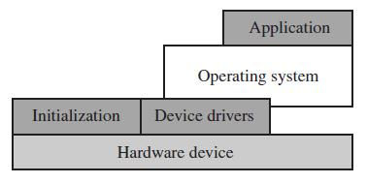
EMBEDDED SYSTEM SOFTWARE
An embedded system needs software to drive it
The following Figure shows four typical software components required to control an embedded device
Software Abstraction Layers Executing on Hardware

Slide 69
The initialization code is the first code executed on the board and is specific to a particular target or group of targets
It sets up the minimum parts of the board before handing control over to the operating system
The operating system provides an infrastructure to control applications and manage hardware system resources

Slide 70
The device drivers provide a consistent software interface to the peripherals on the hardware device
An application performs one of the tasks required for a device ; For example, a mobile phone might have a diary application
There may be multiple applications running on the same device, controlled by the operating system

Slide 71
Initialization (Boot) Code
Initialization code (or boot code) takes the processor from the reset state to a state where the operating system can run
It usually configures the memory controller and processor caches and initializes some devices
The initialization code handles a number of administrative tasks prior to handing control over to an operating system image
We can group these different tasks into three phases: initial hardware configuration, diagnostics, and booting

Slide 72
Initial hardware configuration involves setting up the target platform, so that it can boot an image
The target platform comes up in a standard configuration; but, this configuration normally requires modification to satisfy the requirements of the booted image

Slide 73
For example, the memory system normally requires reorganization of the memory map
Example:
Initializing or organizing memory is an important part of the initialization code, because many operating systems expect a known memory layout before they can start

Slide 74
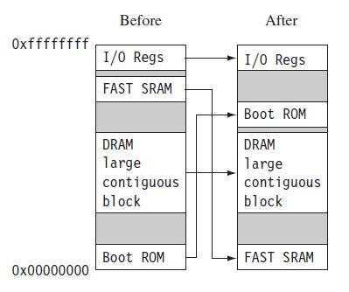
Memory Remapping
Figure shows memory before and after reorganization

Slide 75
It is common for ARM-based embedded systems to provide for memory remapping because it allows the system to start the initialization code from ROM at power-up
The initialization code then redefines or remaps the memory map to place RAM at address 0x00000000 - an important step because then the exception vector table can be in RAM and thus can be reprogrammed

Slide 76
Diagnostics are often embedded in the initialization code
Diagnostic code tests the system by exercising the hardware target to check if the target is in working order
It also tracks down standard system-related issues
The primary purpose of diagnostic code is fault identification and isolation

Slide 77
Booting involves loading an image and handing control over to that image
The boot process itself can be complicated if the system must boot different operating systems or different versions of the same operating system
Booting an image is the final phase, but first you must load the image

Slide 78
Loading an image involves anything from copying an entire program including code and data into RAM, to just copying a data area containing volatile variables into RAM
Once booted, the system hands over control by modifying the program counter to point into the start of the image

Slide 79
Operating System
The initialization process prepares the hardware for an operating system to take control
An operating system organizes the system resources: the peripherals, memory, and processing time

Slide 80
ARM processors support over 50 operating systems
We can divide operating systems into two main categories: real-time operating systems (RTOSs) and platform operating systems

Slide 81
RTOSs provide guaranteed response times to events
Different operating systems have different amounts of control over the system response time
A hard real-time application requires a guaranteed response to work at all
In contrast, a soft real-time application requires a good response time, but the performance degrades more gracefully if the response time overruns

Slide 82
Platform operating systems require a memory management unit to manage large, non-real-time applications and tend to have secondary storage
The Linux operating system is a typical example of a platform operating system

Slide 83
Applications
The operating system schedules applications - code dedicated to handle a particular task
An application implements a processing task; the operating system controls the environment

Slide 84
An embedded system can have one active application or several applications running simultaneously
ARM processors are found in numerous market segments, including networking, auto-motive, mobile and consumer devices, mass storage, and imaging

Slide 85
ARM processor is found in networking applications like home gateways, DSL modems for high-speed Internet communication, and 802.11 wireless communications
The mobile device segment is the largest application area for ARM processors, because of mobile phones

Slide 86
ARM processors are also found in mass storage devices such as hard drives and imaging products such as inkjet printer - applications that are cost sensitive and high volume

Slide 87
In contrast, ARM processors are not found in applications that require leading-edge high performance
Because these applications tend to be low volume and high cost, ARM has decided not to focus designs on these types of applications

Slide 88
ARM PROCESSOR FUNDAMENTALS

Slide 89
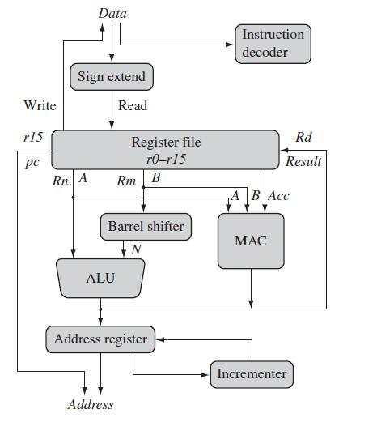
A programmer can think of an ARM core as functional units connected by data buses, as shown in the Figure
ARM Core dataflow Model

Slide 90
The arrows represent the flow of data, the lines represent the buses, and the boxes represent either an operation unit or a storage area
Data enters the processor core through the Data bus
The data may be an instruction to execute or a data item

Slide 91
Figure shows a Von Neumann implementation of the ARM - data items and instructions share the same bus. (In contrast, Harvard implementations of the ARM use two different buses)
The instruction decoder translates instructions before they are executed
Each instruction executed belongs to a particular instruction set

Slide 92
The ARM processor, like all RISC processors, uses load-store architecture - means it has two instruction types for transferring data in and out of the processor:
load instructions copy data from memory to registers in the core
store instructions copy data from registers to memory

Slide 93
There are no data processing instructions that directly manipulate data in memory
Thus, data processing is carried out in registers
Data items are placed in the register file - a storage bank made up of 32-bit registers

Slide 94
Since the ARM core is a 32-bit processor, most instructions treat the registers as holding signed or unsigned 32-bit values
The sign extend hardware converts signed 8-bit and 16-bit numbers to 32-bit values as they are read from memory and placed in a register

Slide 95
ARM instructions typically have two source registers, Rn and Rm, and a single result or destination register, Rd
Source operands are read from the register file using the internal buses A and B, respectively

Slide 96
The ALU (arithmetic logic unit) or MAC (multiply-accumulate unit) takes the register values Rn and Rm from the A and B buses and computes a result
Data processing instructions write the result in Rd directly to the register file

Slide 97
Load and store instructions use the ALU to generate an address to be held in the address register and broadcast on the Address bus
One important feature of the ARM is that register Rm alternatively can be preprocessed in the barrel shifter before it enters the ALU
Together the barrel shifter and ALU can calculate a wide range of expressions and addresses

Slide 98
After passing through the functional units, the result in Rd is written back to the register file using the Result bus
For load and store instructions the Incrementer updates the address register before the core reads or writes the next register value from or to the next sequential memory location
The processor continues executing instructions until an exception or interrupt changes the normal execution flow

Slide 99

REGISTERS
General-purpose registers hold either data or an address
They are identified with the letter r prefixed to the register number
For example, register 4 is given the label r4
The Figure shows the active registers available in user mode. (A protected mode is normally used when executing applications).

Slide 100
The processor can operate in seven different modes
All the registers shown are 32 bits in size
There are up to 18 active registers:
16 data registers and 2 processor status registers
The data registers visible to the programmer are r0 to r15

Slide 101
The ARM processor has three registers assigned to a particular task or special function: r13, r14, and r15
They are given with different labels to differentiate them from the other registers

Slide 102
Register r13 is traditionally used as the stack pointer (sp) and stores the head of the stack in the current processor mode
Register r14 is called the link register (lr) and is where the core puts the return address whenever it calls a subroutine
Register r15 is the program counter (pc) and contains the address of the next instruction to be fetched by the processor

Slide 103
In ARM state the registers r0 to r13 are orthogonal - any instruction that you can apply to r0 you can equally well apply to any of the other registers
In addition to the 16 data registers, there are two program status registers: cpsr (current program status register) and spsr (saved program status register)

Slide 104
CURRENT PROGRAM STATUS REGISTER
The ARM core uses the cpsr to monitor and control internal operations
The cpsr is a dedicated 32-bit register and resides in the register file

Slide 105
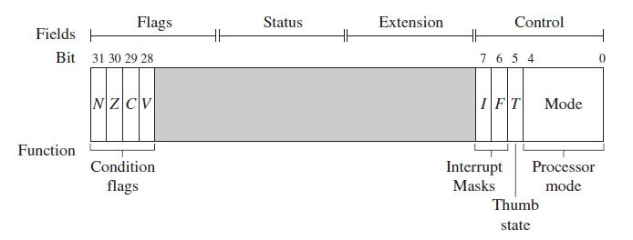
The following Figure shows the basic layout of a generic program status register
Note that the shaded parts are reserved for future expansion
A Generic Program Status Register (psr)

Slide 106
The cpsr is divided into four fields, each 8 bits wide: flags, status, extension, and control
In current designs the extension and status fields are reserved for future use
The control field contains the processor mode, state, and interrupt mask bits
The flags field contains the condition flags

Slide 107
Some ARM processor cores have extra bits allocated
For example, the J bit, which can be found in the flags field, is only available on Jazelle-enabled processors, which execute 8-bit instructions
It is highly probable that future designs will assign extra bits for the monitoring and control of new features

Slide 108
Processor Modes
The processor mode determines which registers are active and the access rights to the cpsr register itself
Each processor mode is either privileged or non-privileged:
A privileged mode allows full read-write access to the cpsr
A non-privileged mode only allows read access to the control field in the cpsr, but still allows read-write access to the condition flags

Slide 109
There are seven processor modes in total: six privileged modes (abort, fast interrupt request, interrupt request, supervisor, system, and undefined)
The processor enters abort mode when there is a failed attempt to access memory
Fast interrupt request and interrupt request modes correspond to the two interrupt levels available on the ARM processor

Slide 110
Supervisor mode is the mode that the processor is in after reset and is generally the mode that an operating system kernel operates in
System mode is a special version of user mode that allows full read-write access to the cpsr
Undefined mode is used when the processor encounters an instruction that is undefined or not supported by the implementation

Slide 111
One non-privileged mode (user)
User mode is used for programs and applications

Slide 112
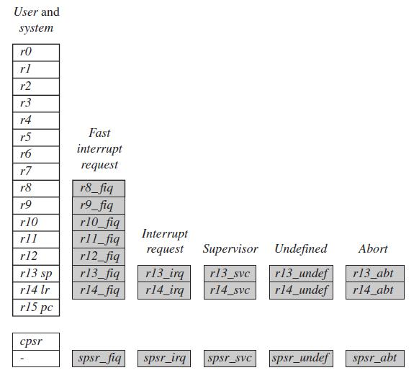
Banked Registers
Complete ARM Register Set

Slide 113
The figure shows all 37 registers in the register file
Of these, 20 registers are hidden from a program at different times
These registers are called banked registers and are identified by the shading in the diagram
They are available only when the processor is in a particular mode; for example, abort mode has banked registers r13_abt, r14_abt and spsr_abt

Slide 114
Banked registers of a particular mode are denoted by an underline character post-fixed to the mode mnemonic or _mode
Every processor mode except user mode can change mode by writing directly to the mode bits of the cpsr
All processor modes except system mode have a set of associated banked registers that are a subset of the main 16 registers
A banked register maps one-to-one onto a user mode register

Slide 115
If you change processor mode, a banked register from the new mode will replace an existing register
For example, when the processor is in the interrupt request mode, the instructions you execute still access registers named r13 and r14
However, these registers are the banked registers r13_irq and r14_irq

Slide 116
The user mode registers r13_usr and r14_usr are not affected by the instruction referencing these registers
A program still has normal access to the other registers r0 to r12

Slide 117
The processor mode can be changed by a program that writes directly to the cpsr (the processor core has to be in privileged mode) or by hardware when the core responds to an exception or interrupt
The following exceptions and interrupts cause a mode change: reset, interrupt request, fast interrupt request, software interrupt, data abort, prefetch abort, and undefined instruction
Exceptions and interrupts suspend the normal execution of sequential instructions and jump to a specific location

Slide 118
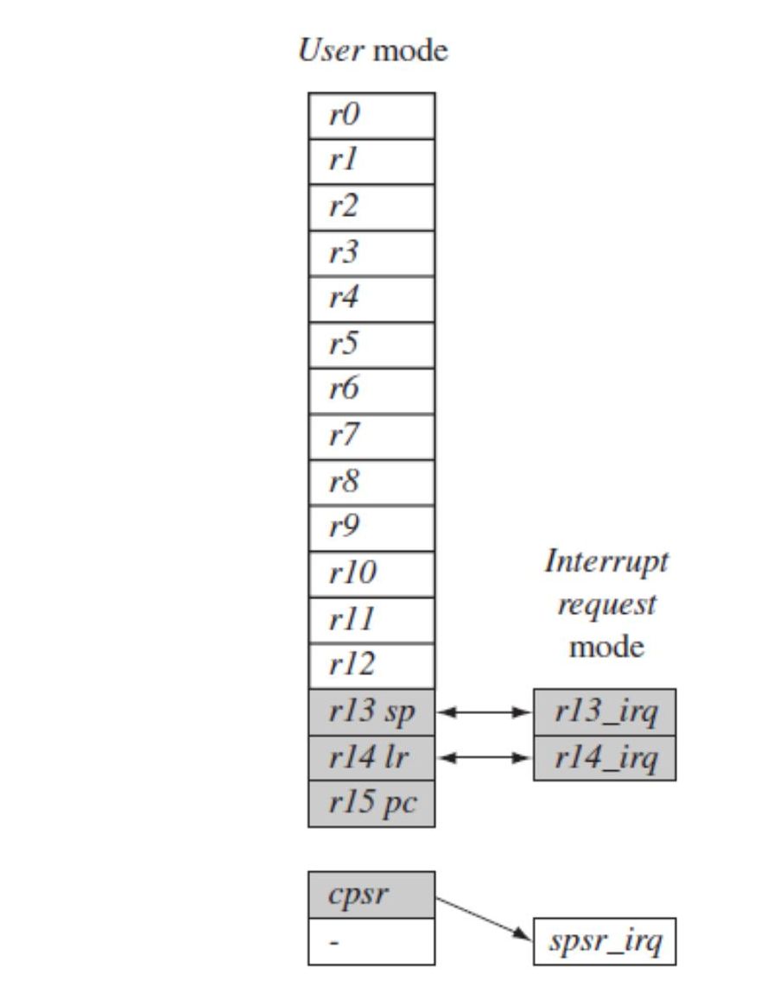
The following Figure illustrates what happens when an interrupt forces a mode change.

Slide 119
The Figure shows the core changing from user mode to interrupt request mode, which happens when an interrupt request occurs due to an external device raising an interrupt to the processor core

Slide 120
This change causes user registers r13 and r14 to be banked
The user registers are replaced with registers r13_irq and r14_irq, respectively
Note r14_irq contains the return address and r13_irq contains the stack pointer for interrupt request mode

Slide 121
The Figure also shows a new register appearing in interrupt request mode: the saved program status register (spsr), which stores the previous mode’s cpsr
The cpsr being copied into spsr_irq
To return back to user mode, a special return instruction is used that instructs the core to restore the original cpsr from the spsr_irq and bank in the user registers r13 and r14

Slide 122
Note that, the spsr can only be modified and read in a privileged mode
There is no spsr available in user mode
Another important feature to note is that the cpsr is not copied into the spsr when a mode change is forced due to a program writing directly to the cpsr
The saving of the cpsr only occurs when an exception or interrupt is raised

Slide 123
When power is applied to the core, it starts in supervisor mode, which is privileged
Starting in a privileged mode is useful since initialization code can use full access to the cpsr to set up the stacks for each of the other modes

Slide 124
The Table lists the various modes and the associated binary patterns
The last column of the table gives the bit patterns that represent each of the processor modes in the cpsr
Table: Processor Mode
Mode | Abbreviation | Privileged | Mode[4:0]
Abort | abt | yes | 10111
Fast Interrupt Request | fiq | yes | 10001
Interrupt Request | irq | yes | 10010
Supervisor | svc | yes | 10011
System | sys | yes | 11111
Undefined | und | yes | 11011
User | usr | no | 10000

Slide 125
State and Instruction Sets
The state of the core determines which instruction set is being executed
There are three instruction sets:
ARM
Thumb
Jazelle

Slide 126
The ARM instruction set is only active when the processor is in ARM state
The Thumb instruction set is only active when the processor is in Thumb state
Once in Thumb state the processor is executing purely Thumb 16-bit instructions
You cannot inter-mingle sequential ARM, Thumb, and Jazelle instructions

Slide 127
The Jazelle J and Thumb T bits in the cpsr reflect the state of the processor
When both J and T bits are 0, the processor is in ARM state and executes ARM instructions
This is the case when power is applied to the processor

Slide 128
When the T bit is 1, then the processor is in Thumb state
To change states the core executes a specialized branch instruction

Slide 129
 | ARM (cspr T = 0) | Thumb (cspr T = 1)
Instruction size | 32-bit | 16-bit
Core instructions | 58 | 30
Conditional execution | most | only branch instructions
Data processing instructions | access to barrel shifter and ALU | separate barrel shifter and ALU instructions
Program status register | read-write in privileged mode | no direct access
Register usage | 15 general-purpose registers + PC | 8 general-purpose registers +7 high registers +PC

Slide 130
The ARM designers introduced a third instruction set called Jazelle
Jazelle executes 8-bit instructions and is a hybrid mix of software and hardware designed to speed up the execution of Java byte-codes
To execute Java byte-codes, you require the Jazelle technology plus a specially modified version of the Java virtual machine

Slide 131
The following Table gives the Jazelle instruction set features.
Jazelle instruction set features
 | Jezelle (cspr T = 0, J – 1)
Instruction size | 8-bit
Core Instructions | Over 60% of the Java byte-codes are implemented in hardware; the rest of the codes are implemented in software

Slide 132
Interrupt Masks
Interrupt masks are used to stop specific interrupt requests from interrupting the processor
There are two interrupt request levels available on the ARM processor core:
interrupt request (IRQ)
fast interrupt request (FIQ)

Slide 133
The cpsr has two interrupt mask bits, 7 and 6 (or I and F), which control the masking of IRQ and FIQ, respectively
The I bit masks IRQ when set to binary 1; and similarly, the F bit masks FIQ when set to binary 1

Slide 134

PIPELINE
ARM7 Three-stage Pipeline

Slide 135
The above Figure shows a three-stage pipeline:
Fetch loads an instruction from memory
Decode identifies the instruction to be executed
Execute processes the instruction and writes the result back to a register

Slide 136
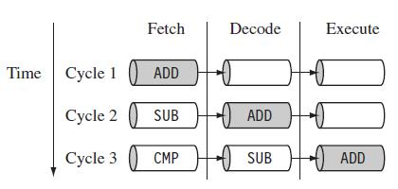
Pipelined Instruction Sequence

Slide 137
The Figure shows a sequence of three instructions being fetched, decoded, and executed by the processor
The three instructions are placed into the pipeline sequentially
In the first cycle, the core fetches the ADD instruction from memory
In the second cycle, the core fetches the SUB instruction and decodes the ADD instruction

Slide 138
In the third cycle, both the SUB and ADD instructions are moved along the pipeline
The ADD instruction is executed, the SUB instruction is decoded, and the CMP instruction is fetched
This procedure is called filling the pipeline
The pipeline allows the core to execute an instruction every cycle

Slide 139
As the pipeline length increases, the amount of work done at each stage is reduced, which allows the processor to attain a higher operating frequency
This in turn increases the performance
The increased pipeline length also means increased system latency and there can be data dependency between certain stages

Slide 140
The pipeline design for each ARM family differs
For example, The ARM9 core increases the pipeline length to five stages, as shown in Figure
ARM9 Five-stage Pipeline

Slide 141
The ARM9 adds a memory and writeback stage, which allows the ARM9 to process on average 1.1 Dhrystone MIPS per MHz
Increase the instruction throughput in ARM9 by around 13% compared with an ARM7

Slide 142
Dhrystone is a general-performance benchmark test originally developed by Reinhold Weicker in 1984
This benchmark is used to measure and compare the performance of different computers or, in this case, the efficiency of the code generated for the same computer by different compilers

Slide 143
Thank You!!!

